Slide 1


E-Commerce
Under Guidance of:
Pooja Mehta
Submitted By:
1. Meghraj Lot
2. Rutik Thosar
3. Hrushikesh Sarode
4. Anand Panmand
5. Shreyas Patil
6. Kiran Shinde
7. Pallavi Shintre

Slide 2
INTRODUCTION
E-commerce has become an integral part of the modern business landscape, allowing customers to browse and purchase products or services online. In this project, we will explore the development of an e-commerce website using Java, Spring, and Angular, three popular technologies known for their robustness, scalability, and ease of use. developing an e-commerce website using Java, Spring, and Angular provides a powerful combination of technologies to create a secure, scalable, and feature-rich online shopping experience. Java's backend capabilities, Spring's comprehensive framework, and Angular's dynamic frontend make this trio a popular choice for building modern e-commerce platforms. By leveraging their strengths and integrating them seamlessly, we can create an efficient and user-friendly online shopping solution.

Slide 3
PROJECT OBJECTIVE
The objective of this e-commerce website project is to create a user-friendly platform where customers can conveniently browse, search for, and purchase products or services. Key goals include providing an intuitive interface with easy navigation, ensuring efficient product management, streamlining order processing, enabling user authentication and personalization, and optimizing scalability and performance. By achieving these objectives, the website aims to enhance the overall shopping experience, increase customer satisfaction, and support business growth.

Slide 4
TECHNOLOGIES USED
Spring Boot
MySQL
RESTful API
Angular

Slide 5
PROPOSED SYSTEM
System needs store information about new entry of Item. System needs to help the internal staff to keep information of Category and find them as per various queries. System need to maintain quantity record. System need to keep the record of Customer. System need to update and delete the record. It also needs a security system to prevent data.

Slide 6
REQUIRED SPECIFICATIONS
Hardware Configuration | Software Configuration
Operating System : Windows 10 and above | Software IDE: Eclipse, Postman, MySQL, VS Code.
Hard Disk: 500 GB | Language: JAVA, Type Script, HTML, CSS
RAM: 8 GB | Front End: Angular, Boot Strap
 | Back End: Spring Boot, MySQL.

Slide 7
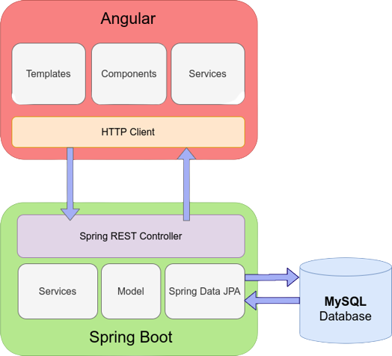
CONNECTION TO DATABASE FRONT END TO BACK END

Slide 8
MODULES
The system contains 5 Modules
ADMIN - Registration and Login.
CUSTOMER- Signup and Login.
Item LIST - Add/Edit items by Admin.
CART - Customer can add Item from list
ORDER - It shows items which present in cart and order status.
PAYMENT – Customer has to pay for completion of order.

Slide 9
SPRING ANNOTATIONS
@Controller :The @Controller annotation indicates that a particular class serves the role of a controller. Spring Controller annotation is typically used in combination with annotated handler methods based on the @RequestMapping annotation.
@Autowired: The @Autowired annotation provides more fine-grained control over where and how autowiring should be accomplished.
@RequestMapping : The @RequestMapping is one of the most common annotation used in Spring Web applications. This annotation maps HTTP requests to handler methods of MVC and REST controllers.
@Entity: The @Entity annotation specifies that the class is an entity and is mapped to a database table.

Slide 10
SPRING ANNOTATIONS
@Table: The @Table annotation is used to create a table in database.
@JoinColumn: The @JoinColumn is used to specify a column for joining an entity association or element collection.
@PutMapping : The @PutMapping is used for update the records.
@PostMapping: The @PostMapping is used to create a resource Mapping.
@GetMapping: The @GetMapping is used to read all the inserted records.
@DeleteMapping : The @DeleteMapping is used to delete the records.
@PathVariable: The @Path Variable annotation is used to extract the value from the URL.
@RequestParam: The @RequestParam annotation is used to read the form data and bind it automatically to the parameter present in the provided method.

Slide 11
SPRING ANNOTATIONS
@Request Body: The @RequestBody annotation is applicable to handler methods of spring controller. spring should deserialize a request body into an object.
@OneToOne Mapping: The @OneToOne JPA annotation is used to map the source entity with the target entity, Hibernate maps the tables in your database to the Entity classes in your application.
@OneToMany Mapping: The @OneTo-Many relationship between table A and table B indicates that one row in a table A link to many rows in table B.but one row in table B links to only one row in table A.
@ManyToOne Mapping: The @Many-to-One mapping means that many instances of this entity are mapped to one instance of another entity.

Slide 12
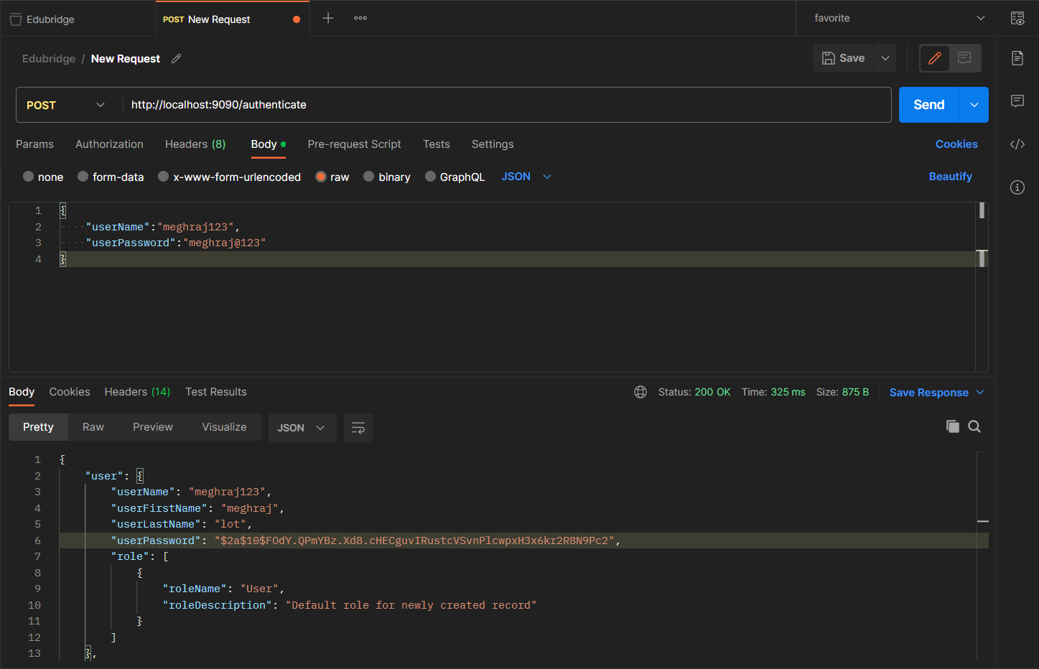
ADMIN REGISTRATION FROM POSTMAN

Slide 13
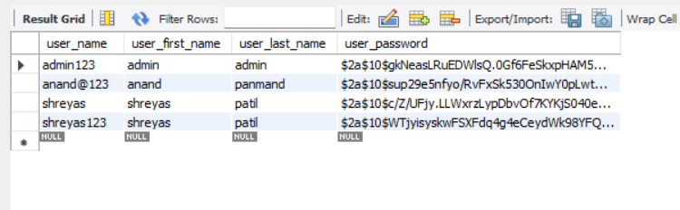
USER TABLE

Slide 14
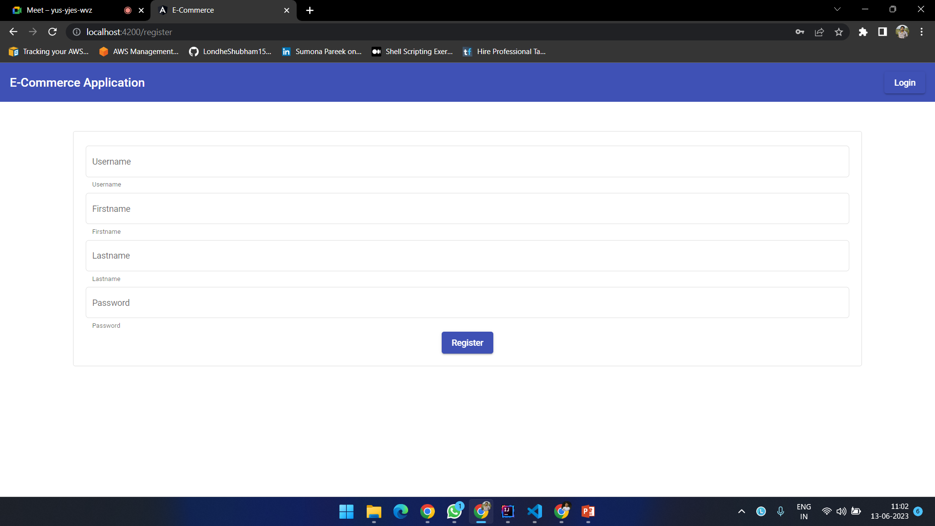
CUSTOMER REGISTRATION

Slide 15
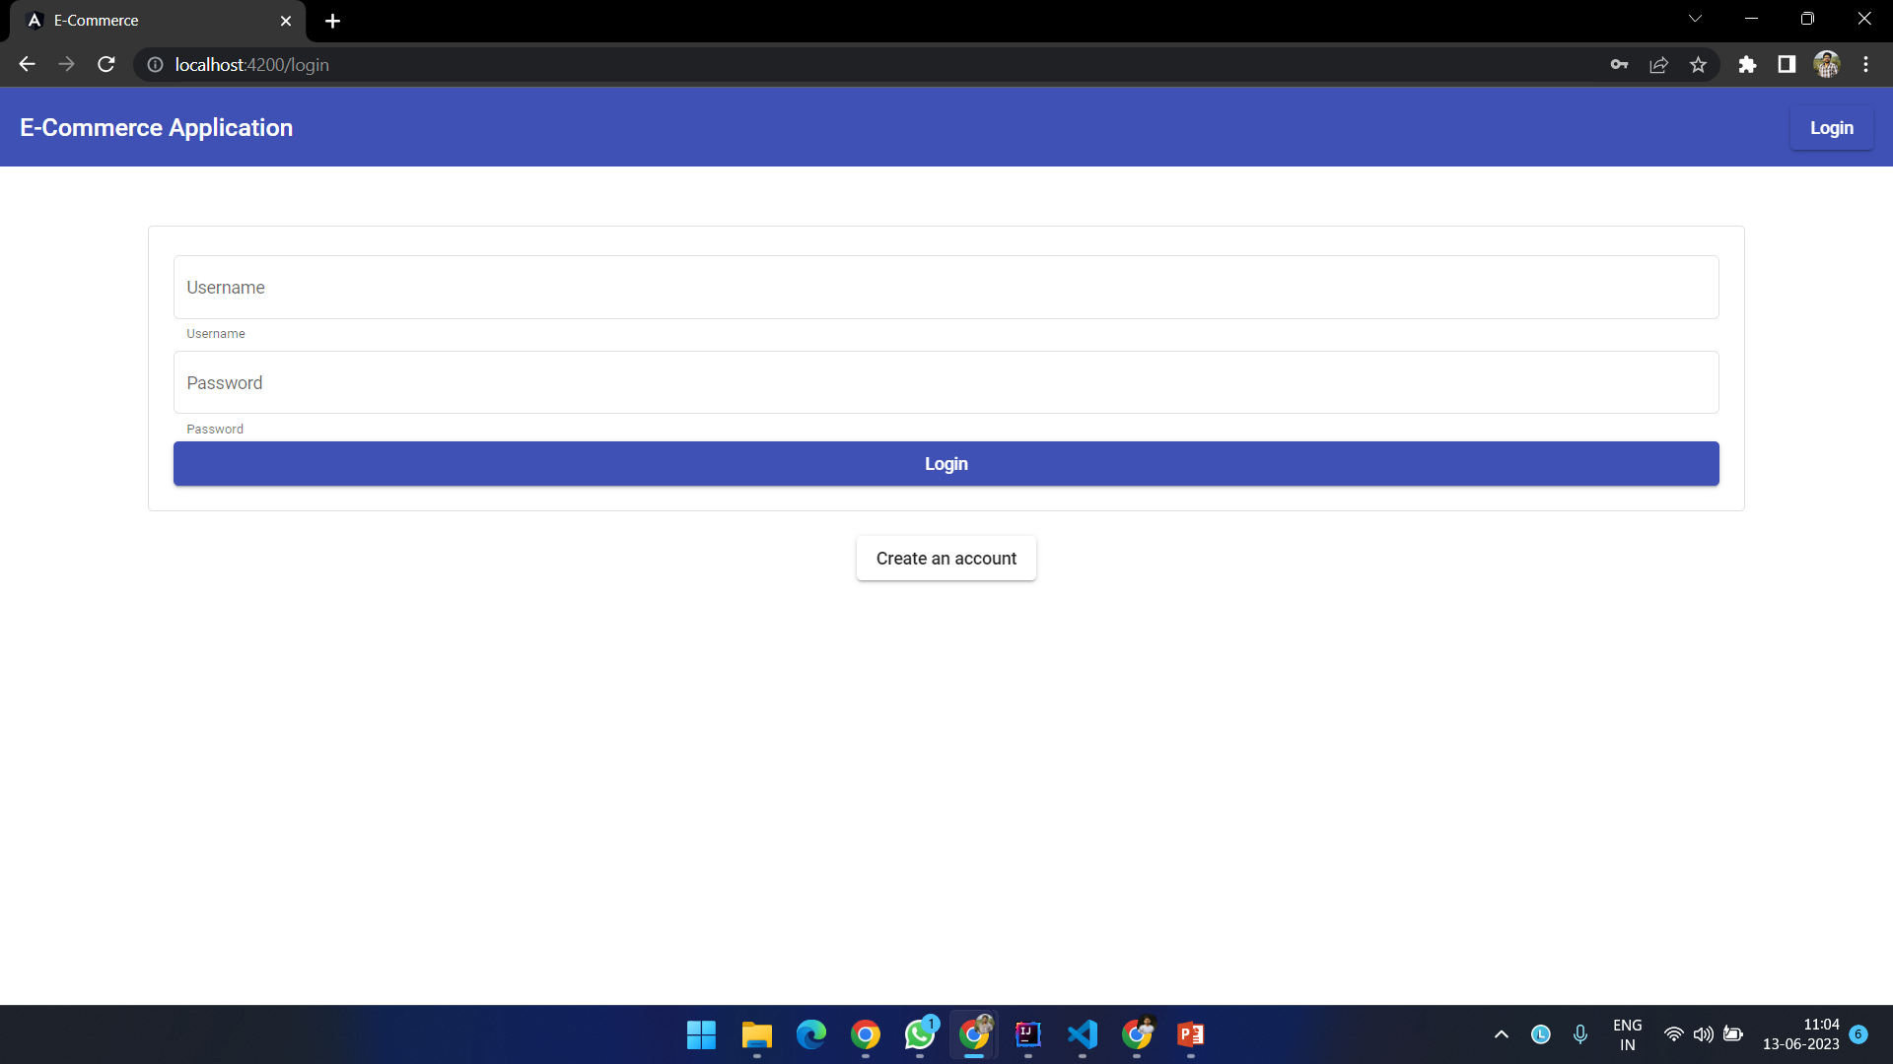
LOGIN

Slide 16
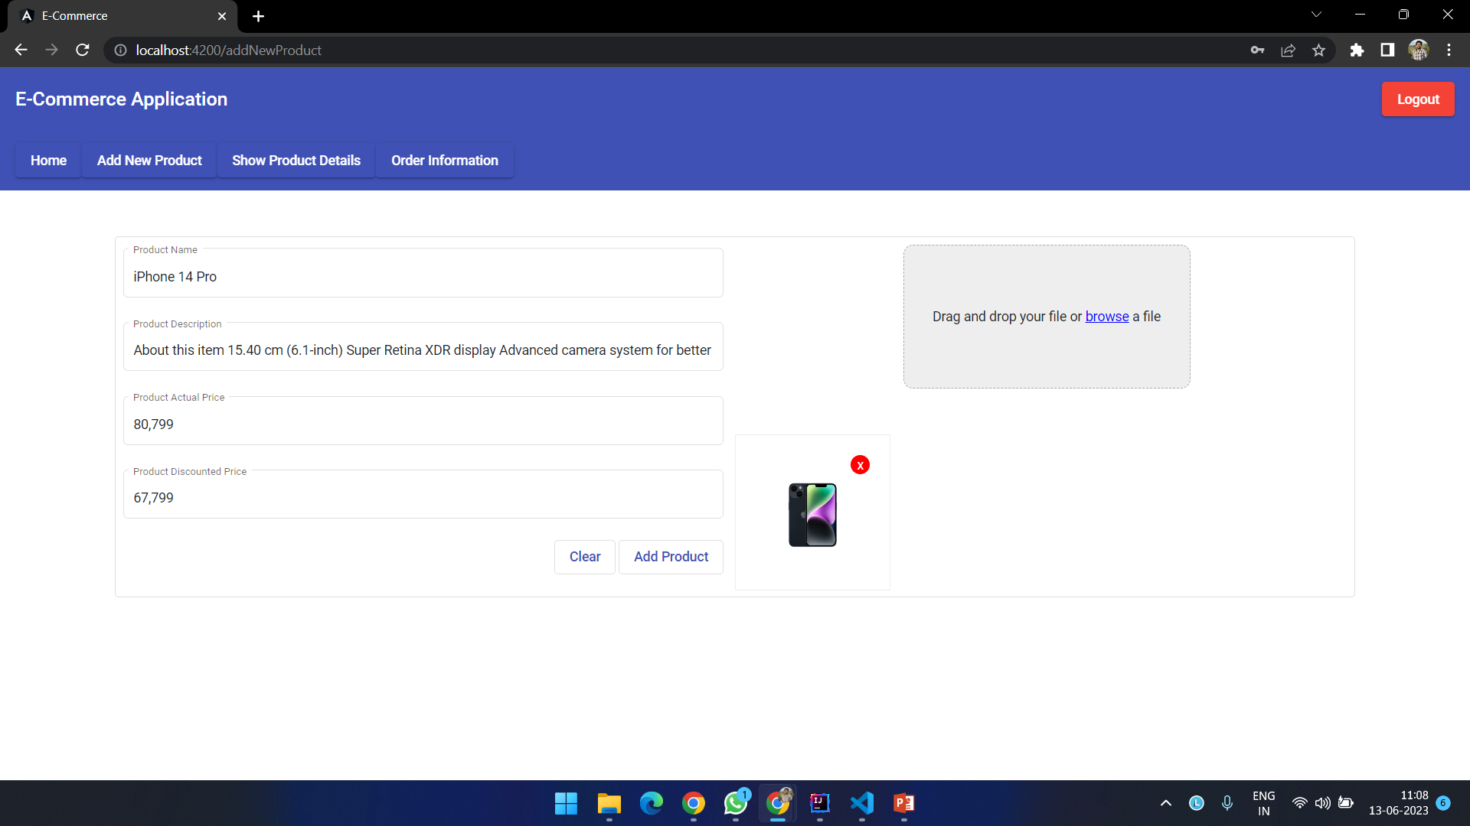
ADD ITEM FROM ADMIN

Slide 17
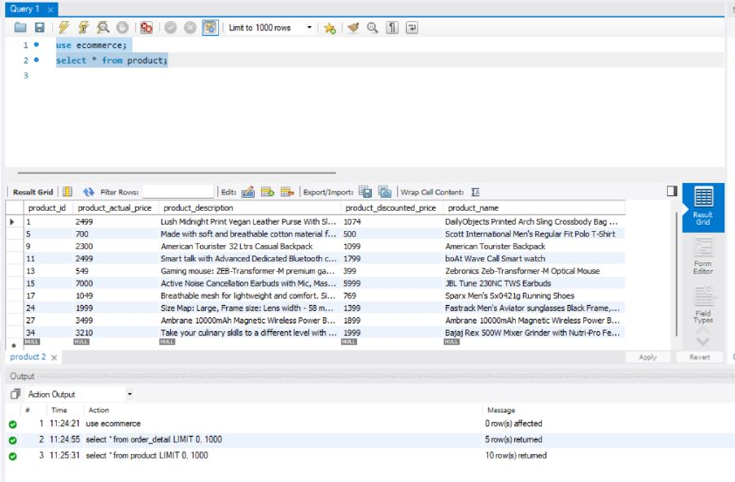
PRODUCT TABLE

Slide 18
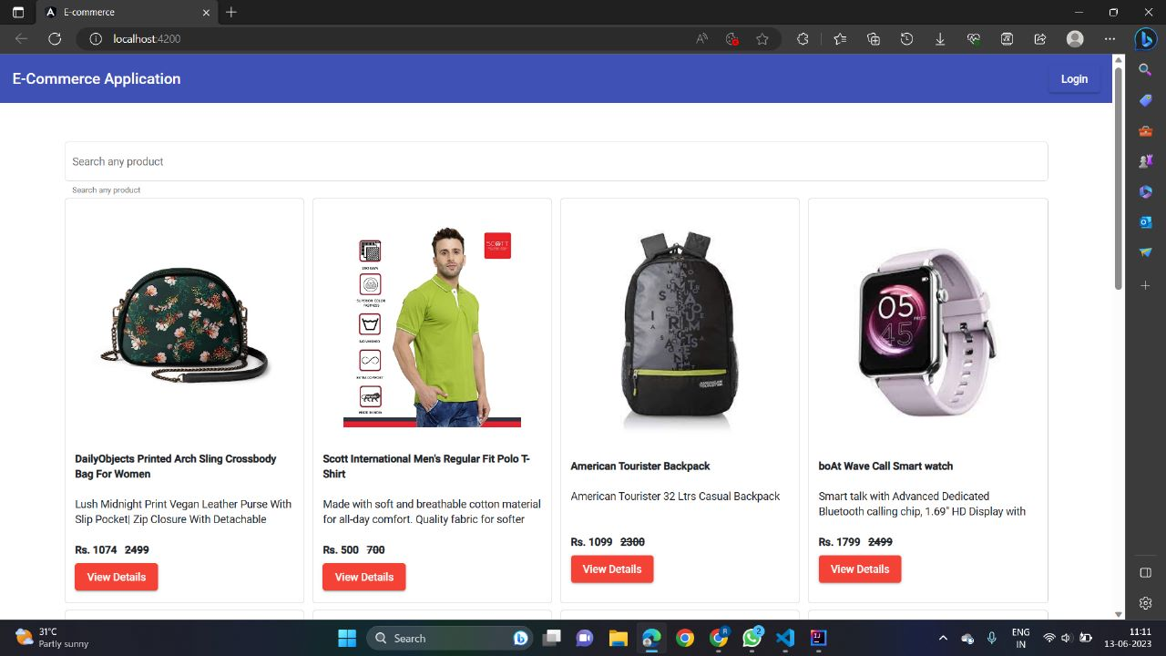
PRODUCT LIST

Slide 19
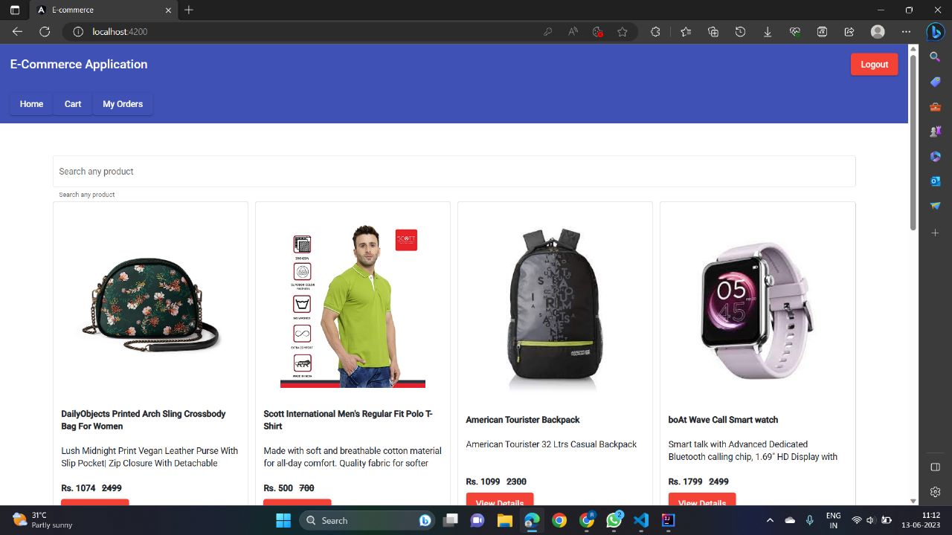
CUSTOMER HOME PAGE

Slide 20
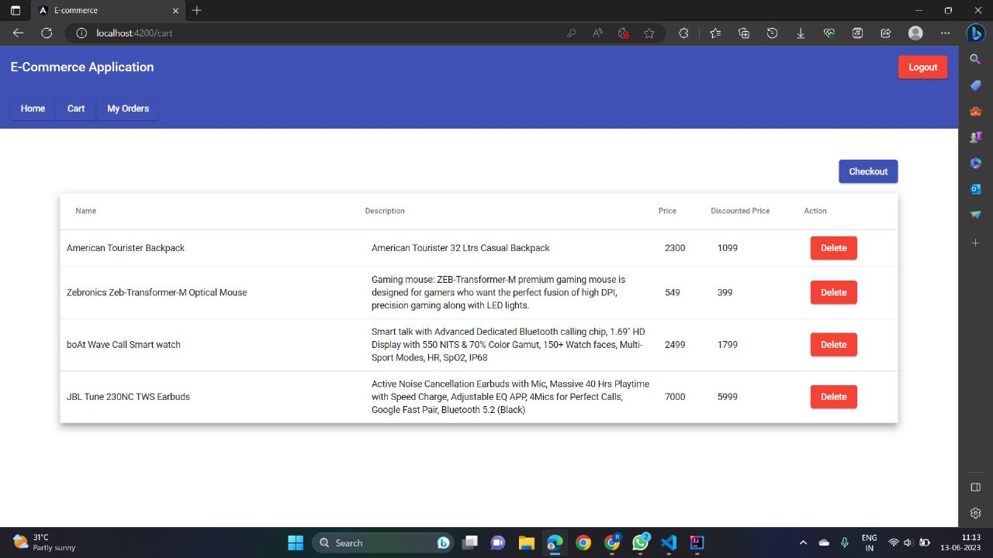
CUSTOMER CART

Slide 21
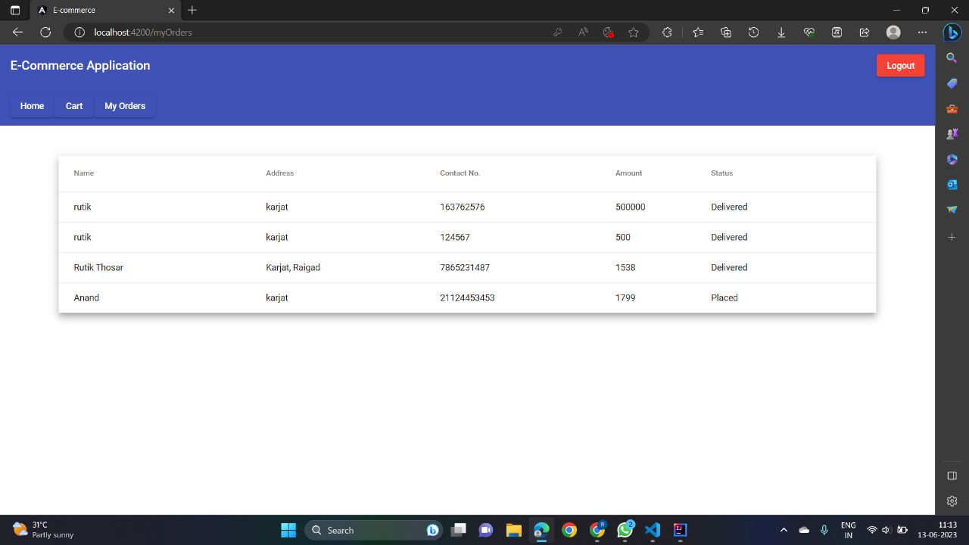
CUSTOMER ORDER

Slide 22
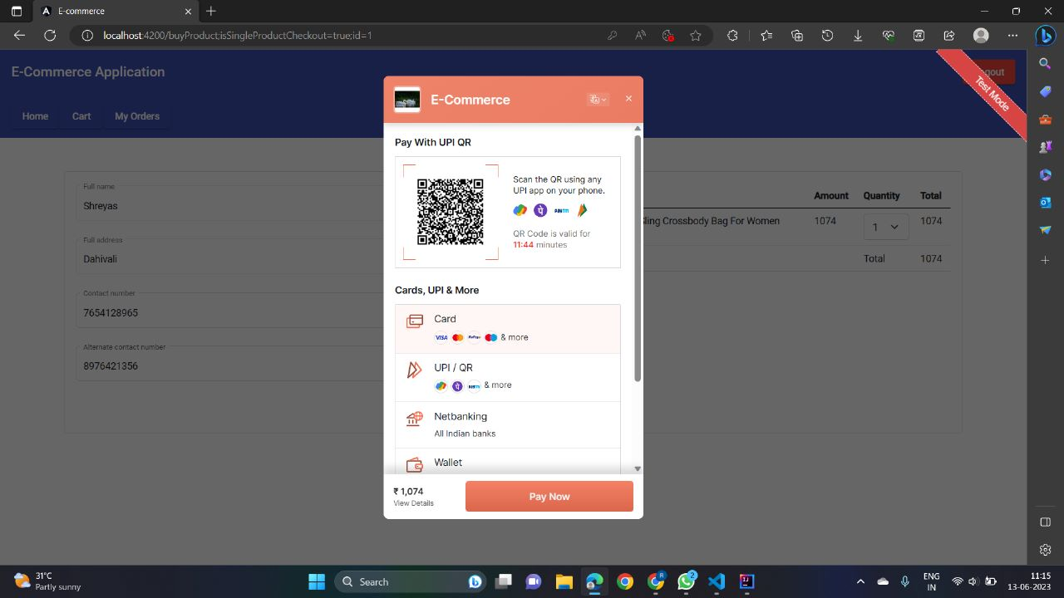
CUSTOMER PAYMENT

Slide 23
ADVANTAGES
Customer can order whenever they want..
Makes the ordering process easier.
Customer's satisfaction.
The convenience of mobile ordering
No more waiting in long queues to place an order.
Discover New Items.

Slide 24
CONCLUSION
The e-commerce project has been highly successful, with a user-friendly platform that boosts sales and revenue. It has expanded the business's market reach, streamlined operations, and utilized data for informed decision-making. The platform's convenience has attracted global customers, while automated features have enhanced efficiency. Data-driven insights have improved marketing strategies, resulting in increased customer satisfaction and loyalty. Overall, the e-commerce project has delivered substantial benefits, such as increased revenue, expanded market presence, streamlined operations, and effective use of data. It has positioned the business for long-term success in the digital realm.

Slide 25
THANK YOU

